Slide 1
Bank Management System
Vaibhav Dabgotra

Slide 2
Contents
Introduction
System Architecture
Technologies Used
Project Features
Code Snippets
Conclusion

Slide 3

Introduction
A Bank Management System is a software application
It is designed to streamline and automate the various operations and processes within a bank.
It encompasses a range of functionalities, including account creation, transaction processing

Slide 4
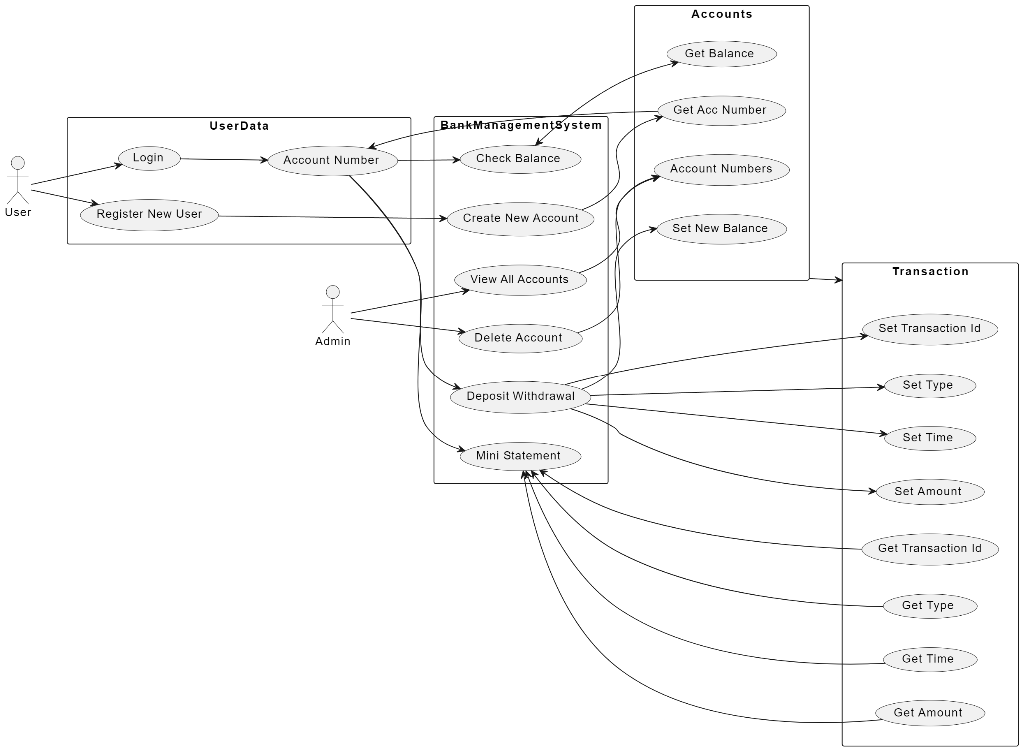
Use Case Diagram

Slide 5
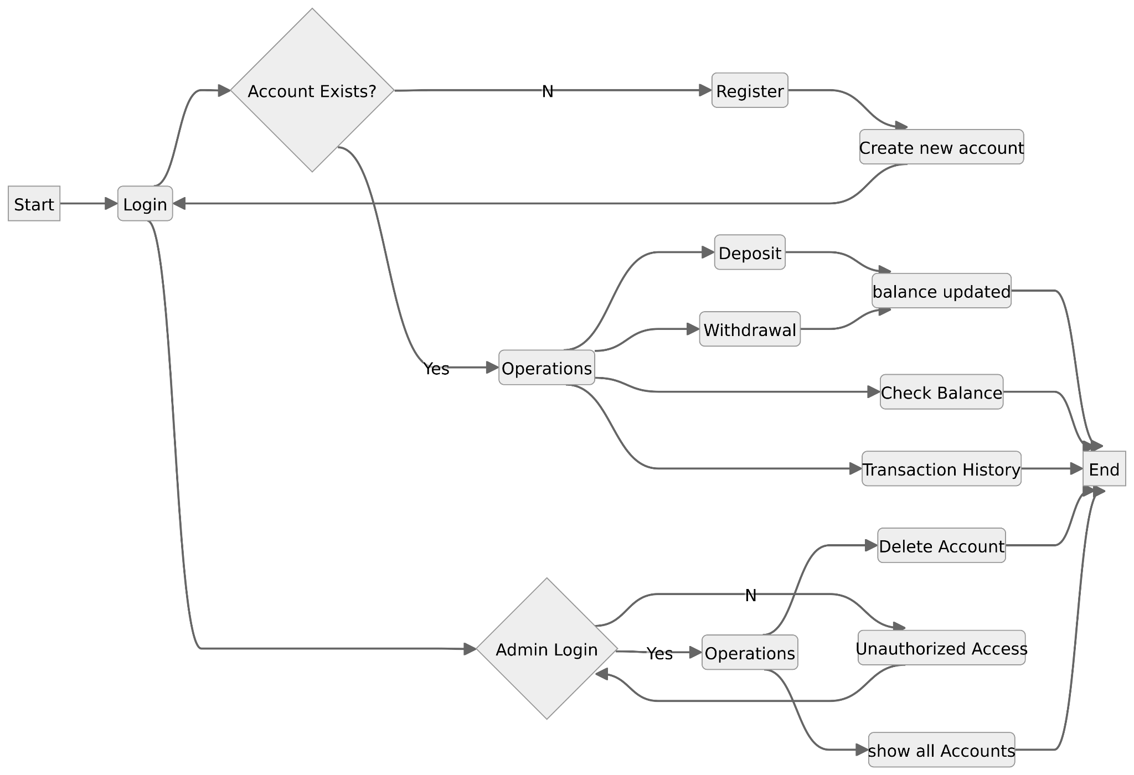
Data Flow Diagram

Slide 6


Technologies
Programming Language: Python
Versatility, readability, and extensive ecosystem of libraries and frameworks.
Python's syntax is clear and concise
Excellent choice for developing complex systems
Database: Microsoft SQL Server (MSSQL)
MSSQL is a relational database management system (RDBMS)
Robust features, scalability, and integration capabilities.
Secure and efficient platform for storing, retrieving, and managing structured data.

Slide 7
Project Features
User Authentication:
The User class has a method called login which prompts the user to enter a username and password.
It checks if the entered username exists in the database and if the corresponding password is correct.
If the credentials are valid, it sets the log_acc attribute, indicating that the user is logged in.
This feature ensures that only authorized users can access their accounts.
Mini Statement:
The mini_transaction method in the Account class retrieves and displays the transaction history for the logged-in user.
It queries the Transactions table for transactions related to the current account and prints details such as transaction ID, type, amount, and timestamp.

Slide 8
Balance Checking:
The check_balance method retrieves and displays the current account balance for the logged-in user.
It queries the Accounts table to fetch the balance corresponding to the logged-in account.
Deposit:
The depos method in the Account class handles the deposit functionality.
It takes an amount as input, generates a new transaction ID, records a 'Deposit' transaction in the Transactions table, and updates the account balance in the Accounts table.
The new balance is then printed to confirm the success of the deposit.
Withdrawal:
The withdraw method in the Account class handles the withdrawal functionality.
It checks if the withdrawal amount is less than or equal to the account balance before processing the withdrawal.
If the withdrawal is allowed, it generates a new transaction ID, records a 'Withdrawal' transaction in the Transactions table, and updates the account balance in the Accounts table.
The new balance is then printed to confirm the success of the withdrawal.

Slide 9
Delete Account:
The deleteAccount() method in the Account class allows the deletion of an account.
It checks if the provided password is correct and if the account balance is zero before allowing deletion.
If the conditions are met, it prompts the user for confirmation and deletes the account from the Accounts table.

Slide 10
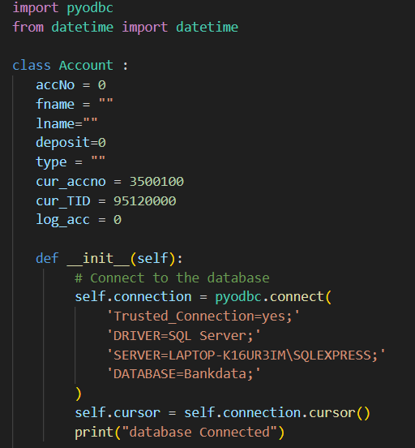
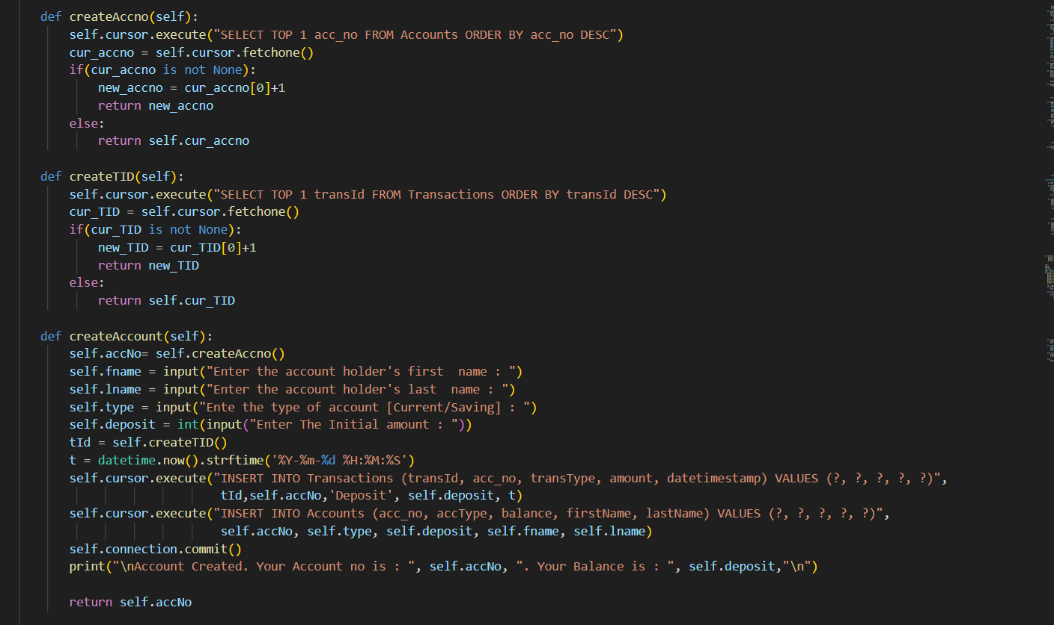
Code Snippets
Database Connection New Account Creation

Slide 11
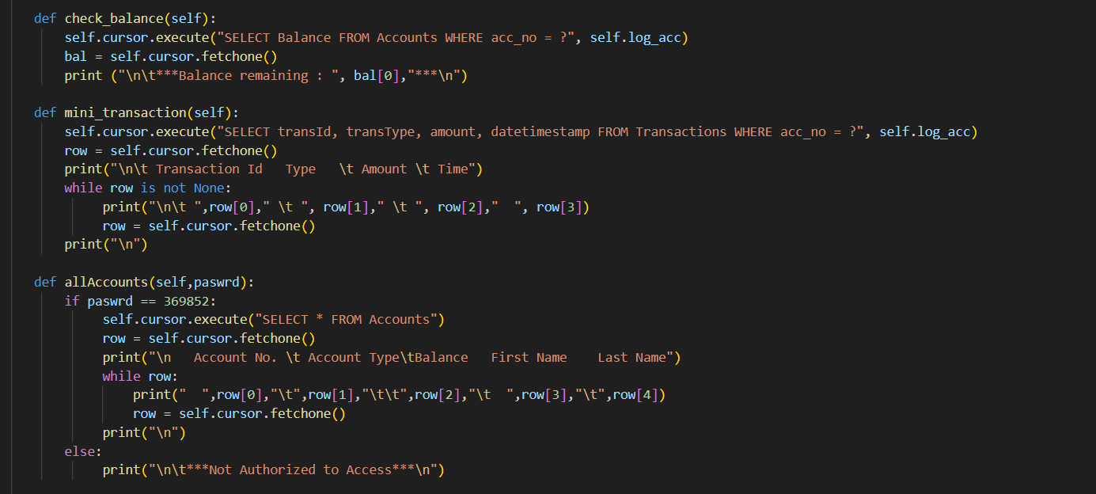
Check Balance, Mini Statement

Slide 12
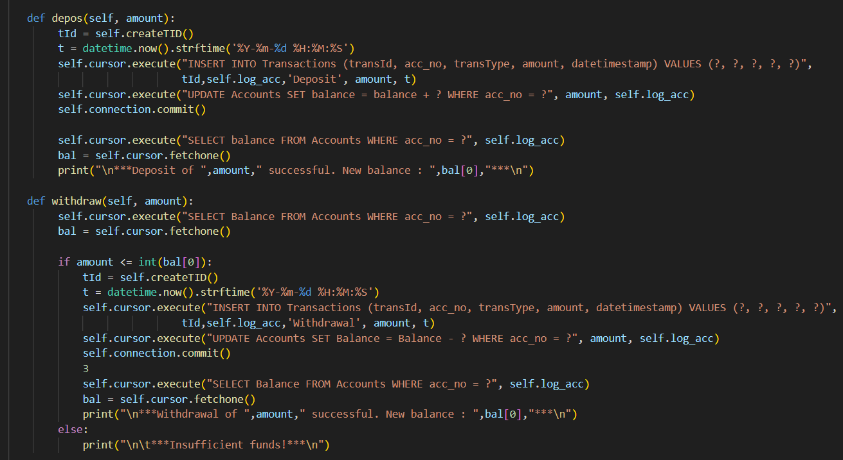
Deposit and Withdrawal

Slide 13
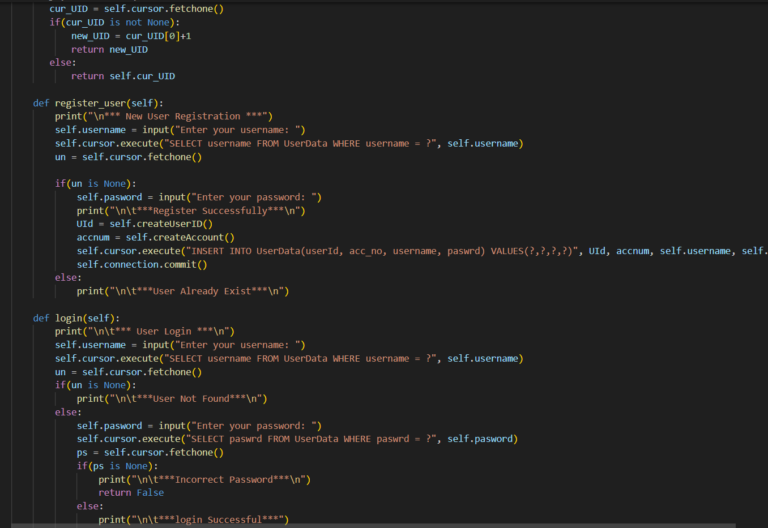
User Registration and Login

Slide 14
Conclusion
The Bank Management System project not only meets the basic requirements of a banking application but also emphasizes security, efficiency, and a user-friendly interface.
The use of Python and MSSQL ensures a solid technological foundation, allowing for scalability and future enhancements.
Overall, this system addresses the complexities of modern banking, offering a reliable solution for both customers and bank administrators.

